Slide 1
Fuzzy Logic and Inferencing
Lecture Module 20

Slide 2
Multi-valued Logic
The classical (two–valued) logic can be extended into three–valued logic denoting truth, falsity and indeterminacy represented by (1,0 and ½).
The basic logic operations (Λ, V, → ) are defined as follows:
X Y X ΛY X V Y X → Y
0 0 0 0 1
0 ½ 0 ½ 1
0 1 0 1 1
½ 0 0 ½ ½
½ ½ ½ ½ 1
½ 1 ½ 1 1
1 0 0 1 0
1 ½ ½ 1 ½
1 1 1 1 1

Slide 3
Contd..
3 – valued logic can be generalized to n-valued logic.
For any given n, the truth values in n-valued logic are usually labeled by rational numbers in the unit interval [0,1].
These values are obtained by evenly dividing the interval between 0 and 1 exclusive.
  The set Tn of truth values of an n-valued logic is thus defined as
Tn = { 0/(n-1), 1/(n-1), 2/(n-1), …, (n-1)/(n-1) }
  These values can be interpreted as degrees of truth.
Basic logic operations (Λ, V, → ) on n-valued logic.
  ~X = (1 – X)
  X Λ Y = Min (X, Y)
  X V Y = Max (X, Y)
  X → Y = Min (1, 1+Y-X)

Slide 4
Fuzzy Logic
There is a natural correspondence between logic and set theory.
∪ V
∩ Λ
⊆ →
Fuzzy logic is a multi-valued logic whereas classical logic (prepositional / predicate) is a two–valued logic.
Membership grade in fuzzy set can be interpreted as truth value of the proposition “x is a member of set”
Fuzzy logic is defined as a form of multi-valued logic.
In fuzzy logic, the degree of truth of a statement can range between 0 and 1 and is not constrained to the binary truth values {True, False} as in predicate logic.

Slide 5
Contd..
Fuzzy reasoning is neither exact nor absolutely inexact but only to certain degree of exact or inexact.
Fuzzy logic allows the use of
  fuzzy predicates {old, expensive, young, strong, weak, rich, poor, etc.}
  fuzzy truth values {fairly true, true, very true, fairly false, false, very false, quite true, etc.}
  fuzzy quantifiers { many, few, almost all, usually, several, frequently, seldom, etc.}
  fuzzy modifiers {likely, almost impossible, extremely unlikely, etc.}

Slide 6
Fuzzy Predicate
Every simple fuzzy statement can be represented in fuzzy logic by a fuzzy predicate statement.
For example,
  Fuzzy statement “x is F”, where F is a fuzzy can be represented as F(x), where F is fuzzy predicate.
Example: John is Young is a fuzzy statement and Young(John) is a fuzzy predicate statement.
The fuzzy predicate is same as the fuzzy set.
Fuzzy statement John is Young is evaluated to get its degree of truth value from fuzzy set Young based on the age of John.

Slide 7
Cont...
Consider the following definition of the fuzzy set Young.
Young = {(5, 1), (10, 1), (15, 1), (20, 0.95), (25, 0.9), (30, 0.8), (35, 0.7), (40, 0.6), (50, 0.45), (60, 0.3), (70, 0.1), (80, 0)}
From this set, we can only find the degree of truth value in terms of membership value
  If John is 30 years old then the membership value or degree of truth value of John in the fuzzy set Young is 0.8.
  Similarly, if age of a person is 20 then its membership value is 0.95 and for age 50, the membership value is 0.45 and so on.

Slide 8
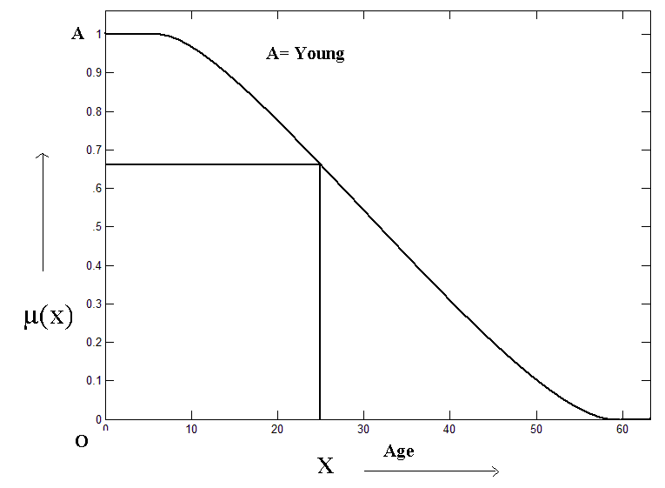

Slide 9
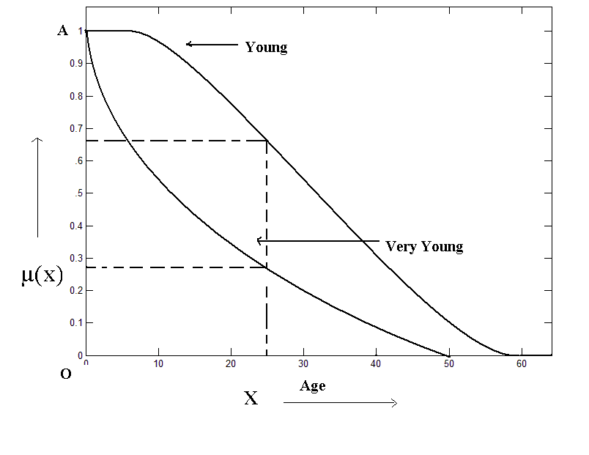
Con(Young)

Slide 10
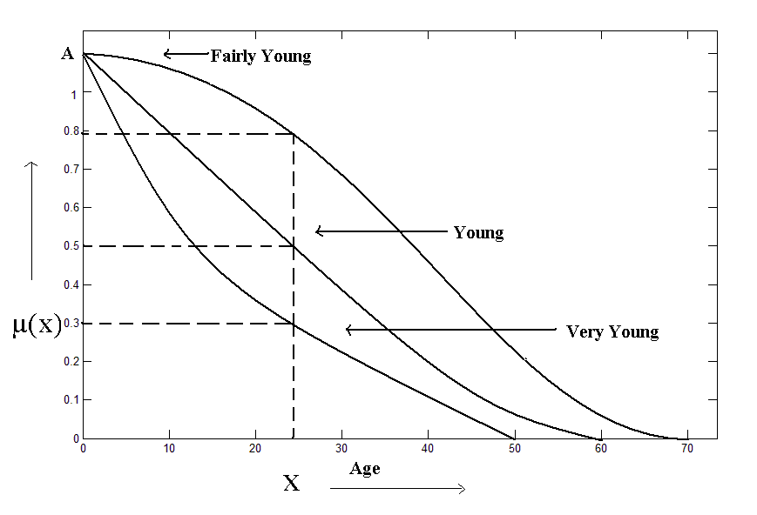
Dil(Young)
Con(Young)

Slide 11
Fuzzy Truth Values
In binary logic, truth values are only true and false.
But in fuzzy logic, there may be number of fuzzy truth values such as
  fairly true; true; very true; fairly false; false; very false etc
Fuzzy values can be obtained by prefixing fuzzy modifiers or hedges such as fairly, very etc.
  Generally, the truth value of fuzzy statements are given in terms of degree of belonging-ness to fuzzy set.
  But if truth values are given in terms of fuzzy truth values, then it gives more natural interpretation.
Fuzzy truth values are fuzzy sets themselves.

Slide 12
Interpretation of Fuzzy Statements
Interpretation of fuzzy statement may be given in terms of fuzzy truth values instead of degree of truth or membership value
For example, if John is 30 years old, then John is Young has degree of truth value as 0.8.
  This number does not convey much to novice reader unless he knows the interpretation of it.
  Aim is to find the fuzzy truth value of the statement John is Young in terms of true, fairly true or very true etc., instead of 0.8,
  For this we have to find the degree of truth value corresponding to 0.8 in fuzzy sets representing fuzzy truth values.

Slide 13
Fuzzy Sets for Fuzzy Truth Values.
Let us divide the membership range [0, 1] into six fuzzy set corresponding to fuzzy truth values namely
  very false-VF,
  false-F,
  fairly false-FF,
  fairly true-FT,
  true-T and
  very true-VT.
Assume that degree of membership value of a statement X in the fuzzy set F is say, D in the range [0,1], then we can find membership value of D using the graph on next page.
Higher degree set is chosen as its interpretation.

Slide 14
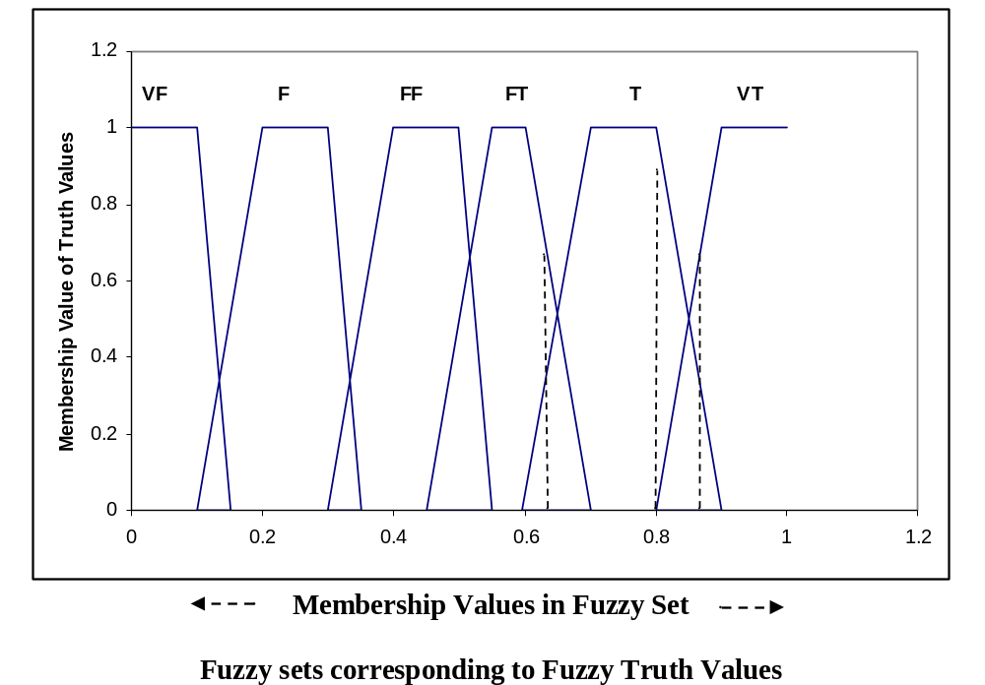
Graphs for Fuzzy Truth Sets
0.65
0.87

Slide 15
Interpretation - Examples
Assume that the degree of membership of a statement John is Young in fuzzy set Young is 0.8.
  Membership value corresponding to 0.8 belongs to True set more as compared to fairly true or very true.
  So interpretation is that John is Young is true.
If membership value of a statement John is Young is 0.65, then the truth value comes out to be fairly true as degree in FT set is higher than degree in T.
  So interpretation is that John is Young is fairly true.
If membership value of a statement John is Young is 0.87, then the truth value comes out to be very true as degree in VT set is higher than degree in T.
  So interpretation is that John is Young is very true.

Slide 16
Fuzzy Propositions
There are four types of simple fuzzy propositions
  Unconditional and unqualified propositions
  Unconditional and qualified propositions
  Conditional and unqualified propositions
  Conditional and qualified propositions

Slide 17
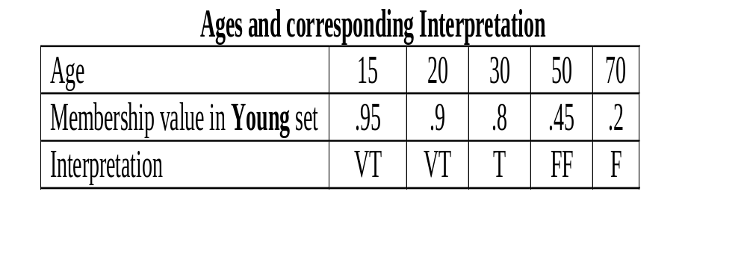
Unconditional and unqualified Propositions
The canonical form of this type is “x is A”, where x ∈ X and A is a fuzzy set on X.
  For example, temperature is high, Tina is young, john is tall etc.

Slide 18
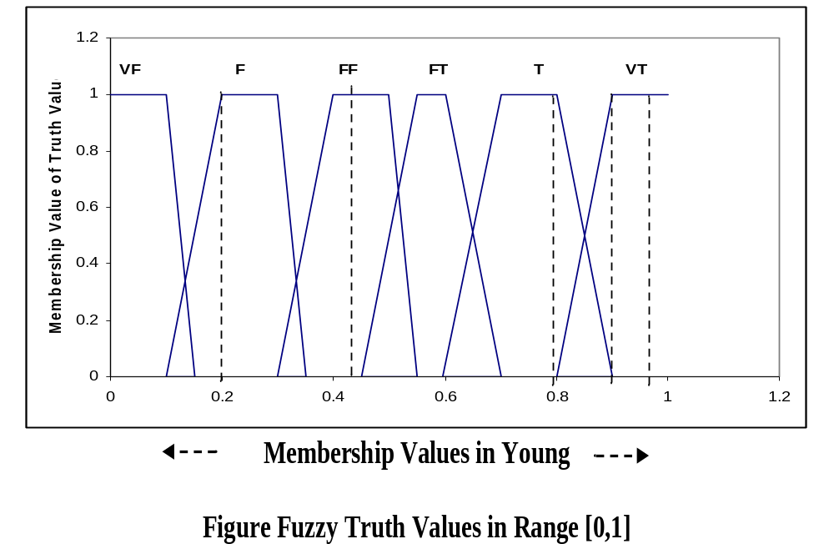

Slide 19
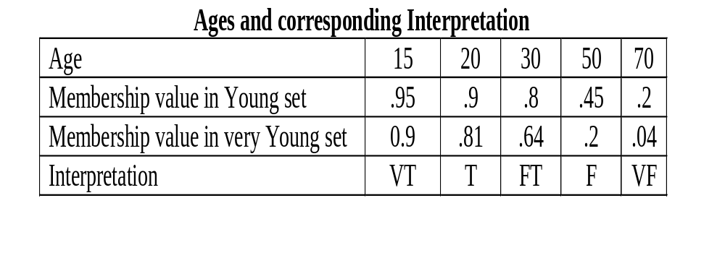
Cont…
Find the interpretation of a fuzzy statement “x is very Young” for various ages.
The following Table contains its membership value of various ages in fuzzy set Young then the membership value in very Young set using CON operator

Slide 20
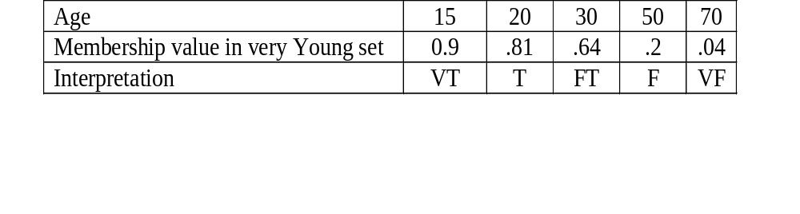
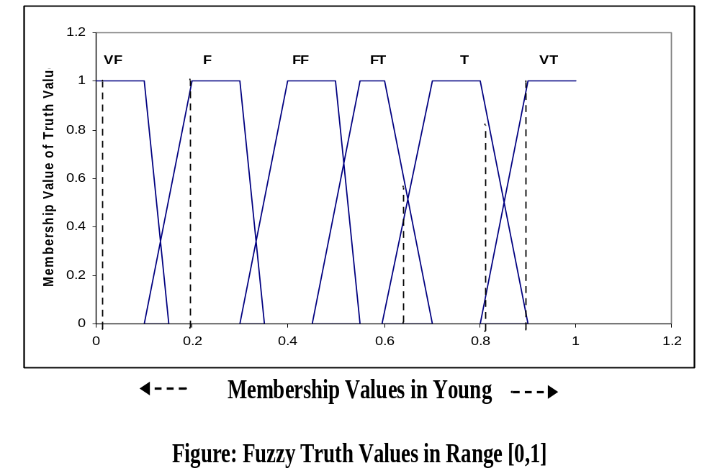

Slide 21
Unconditional and qualified propositions
The canonical form of unconditional and qualified propositions may be expressed as follows:
P: x is A is R, where R is a fuzzy truth qualifier
Examples of unconditional but qualified propositions.
  John is young is true
  John is young is very true
The interpretation of such statements involves determining the degree of truth value.
Initially degree of truth value of x in A is determined as x1, then T(P) = Degree of truth value of x1 in fuzzy set R.
Table on next slide shows the degree of truth value of a statement x is young is very true along with its corresponding interpretations.

Slide 22
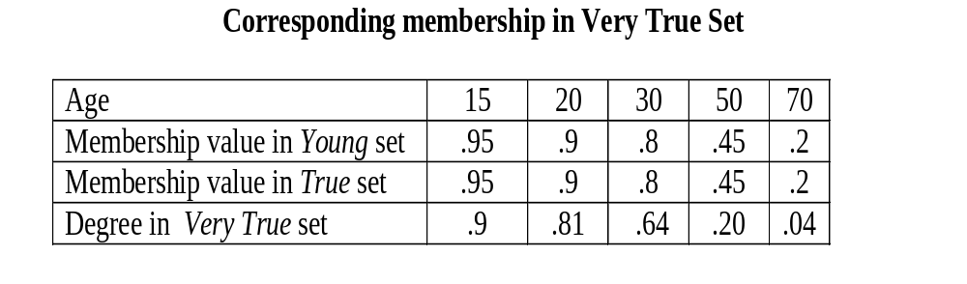
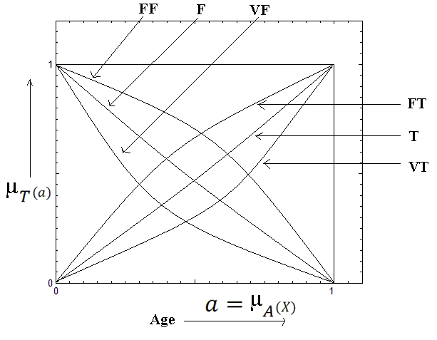

Slide 23
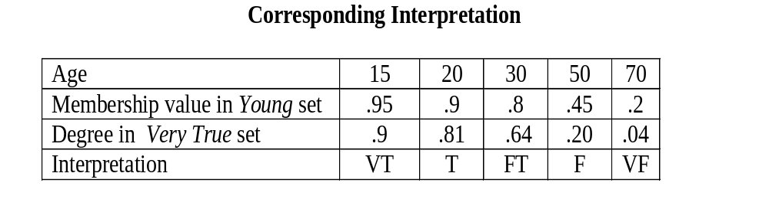
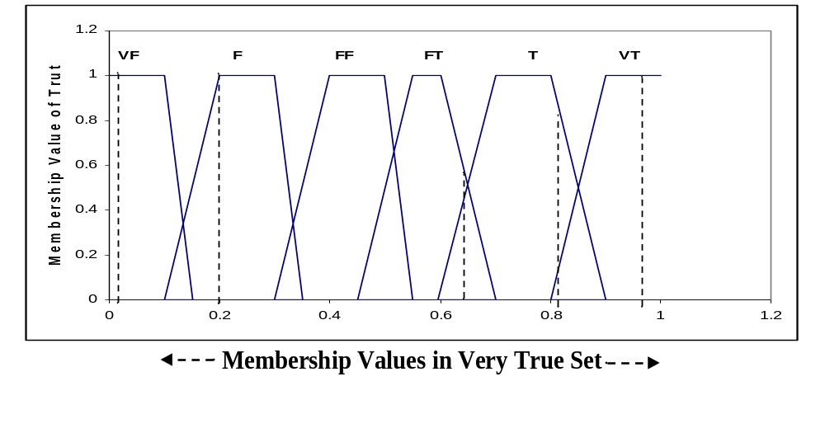

Slide 24
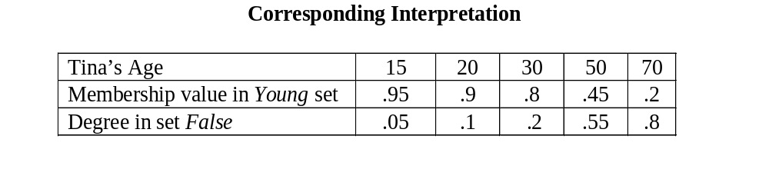
Similarly, the degree of truth value of a statement Tina is young is false is computed.

Slide 25
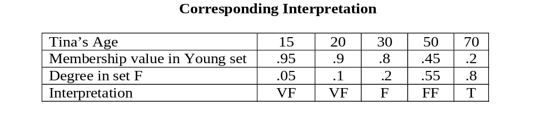
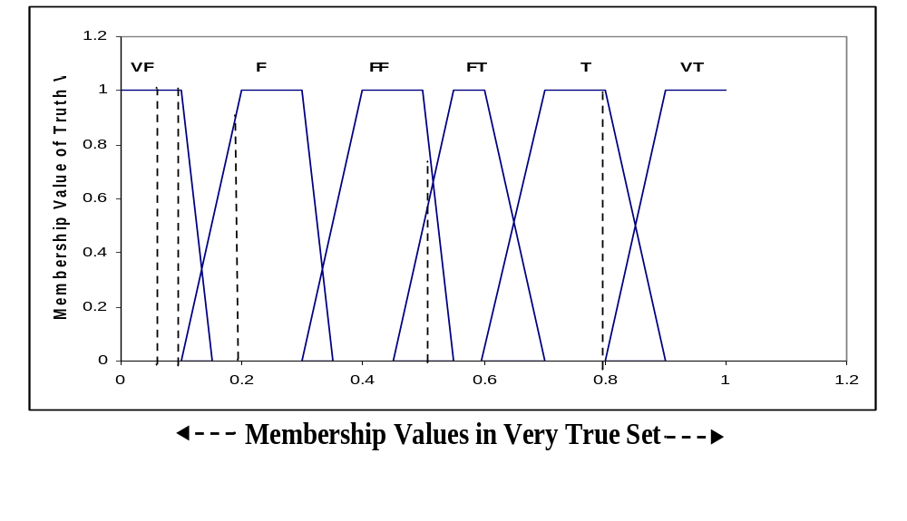

Slide 26
Contd..
If Tina’s age is
  Age = 15 then x is Young is false is very false
  Age =20, then x is Young is false is very false
  Age = 30, then x is Young is false fairly false
  Age = 50 then x is Young is false fairly false
  Age = 70 then x is Young is false true

Slide 27
Conditional and Unqualified Propositions
The canonical form of conditional and unqualified propositions may be represented as
P : if x is A then y is B, where x ∈ U1, y ∈ U2, and A and B are fuzzy sets on U1 and U2, respectively.
Example: If sun is bright, then day is hot. Here, bright and hot are fuzzy sets.
The interpretation of the statement
  If sun is bright, then day is hot is true,
  If sun is bright, then day is cold is very false.
The truth interpretation can be easily obtained as suggested earlier when discussed FIS.
This type of proposition is a simple fuzzy if–then rule.

Slide 28
Conditional and Qualified Propositions
The canonical form of conditional and qualified propositions is expressed as follows:
P: if x is A, then y is B is R
  Here x ∈ U1, y ∈ U2, A is a fuzzy set on U1, B is a fuzzy set on U2, and R is a fuzzy truth qualifier.
For example, if the following propositions are given:
  P : if sun is bright then day is hot is fairly false
  P1 : if sun is bright then day is hot is fairly true
The interpretation of statements P and P1 might be very false and very true, respectively.

